Slide 1
Applied Deep Learning
Classification of Chemical Compounds by Magnetic Order
Muhamad Alawad 12402140

Slide 2
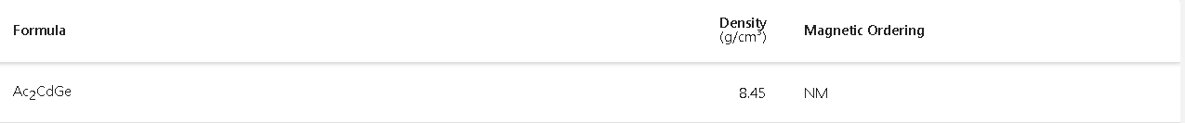
Problem Statement
Classifying Materials by their Magnetic Ordering
Input feature x: chemical formula + density (119-vector)
Output: the magnetic order (Ferro, Non, Ferri, Anti) (4-vector)

Slide 3
Problem Significance
Experimental trials are expensive and time consuming
Inferring the magnetic properties by known features saves recourses
In literature most researchers use non-deep learning approaches and limit the scope of their model (e.g. organic , materials including )

Slide 4
The Deep Learning Solution
The Architecture used was traditional Neural Networks.
The model details are as follows:
Parameters number: ~ 2,000,000
Number of layers 40 layers with SiLU activation
Number of nodes 256 for hidden layers
Number of nodes in the output layer is 4 with softmax activation
Google Colab Pro TPUs were used to train the model

Slide 5
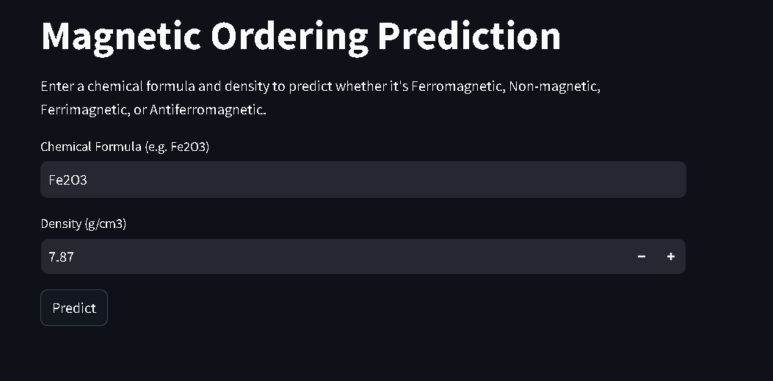
The Demonstration
Streamlit was used
The user inputs the chemical formula and density

Slide 6
The Metrics Used
Categorical accuracy was used
The accuracy reached 65%
No matter how many layers/nodes the accuracy did not change
It was thought that the model reached the “Bayes’ error”

Slide 7
Diagnostics
The performance did not improve and it seems that:
Using only TWO features did hurt the performance
The GNNs would have leveraged locality so it would be a better architecture
Yet the bottleneck was more nuanced and interesting

Slide 8
Diagnostics
The performance did not improve and it seems that:
Using only TWO features did hurt the performance
The GNNs would have leveraged locality so it would be a better architecture
Yet the bottleneck was more nuanced and interesting
Most materials in nature are non-magnetic
The Data is skewed

Slide 9
The issue
The dataset is skewed
The Model seems to output only non-magnetic as an assumption that all materials are not.
The algorithm rendered itself equivalent to a basic print statement.
Print(“non-magnetic”)

Slide 10
Lessons
Understanding the Dataset is crucial as Deep Learning is Data-centric not Algorithm-centric.
During error analysis, relying only on bias and variance is necessary but not sufficient.
Manual error analysis would solve this problem.
If this was anticipated then precision, recall and F1 score would be a better metric than categorical accuracy

Slide 11
Conclusion
Despite powerful frameworks and abundant data, a project’s success hinges on human decisions about
1. data cleaning and understanding,
2. feature engineering
3. metric selection.

